Slide 1
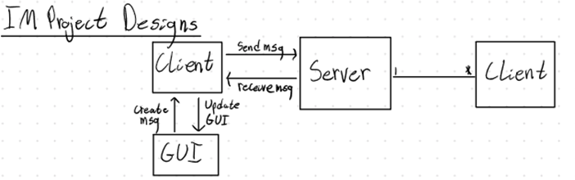
Instant Messenger Architecture Overview
Notes:
Marian

Slide 2
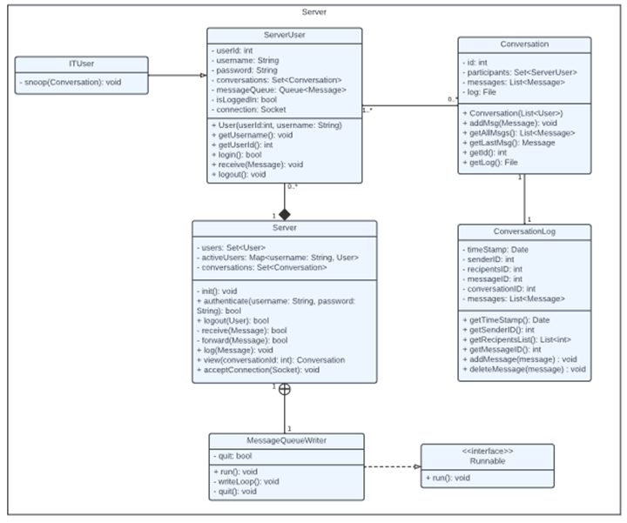
Server Class Diagrams
Notes:
Caleb

Slide 3
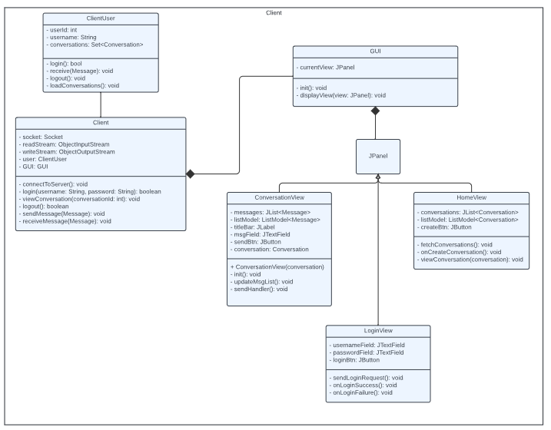
Client Class Diagrams
Notes:
Quang

Slide 4
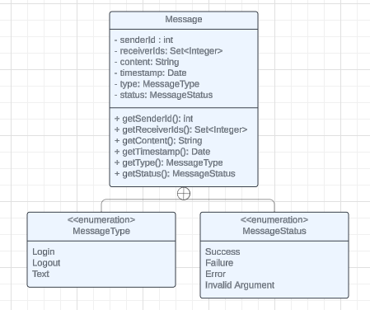
Message Class Diagrams
Notes:
Quang

Slide 5
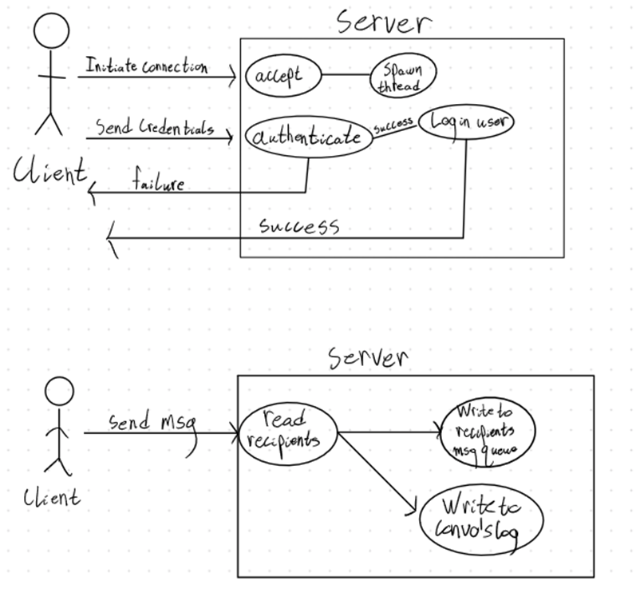
Use Case Diagram for Connecting and Logging In
Notes:
Ashish

Slide 6
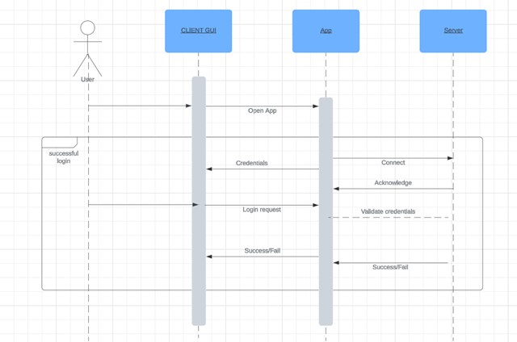
Event Sequence for Logging In
Notes:
Ashish

Slide 7
Use Case Diagram for Sending a Message
Notes:
Caleb

Slide 8
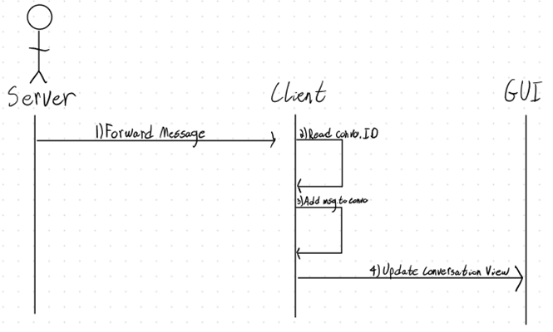
Event Sequence for Receiving a Message (Client Perspective)
Notes:
Caleb

Slide 9
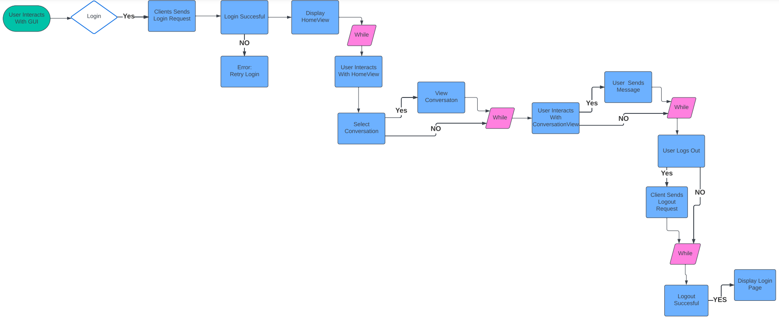
User Logs In
Receive Message View Conversation
Send Message(ConversationView)
LogOut
Notes:
Marian

Slide 10
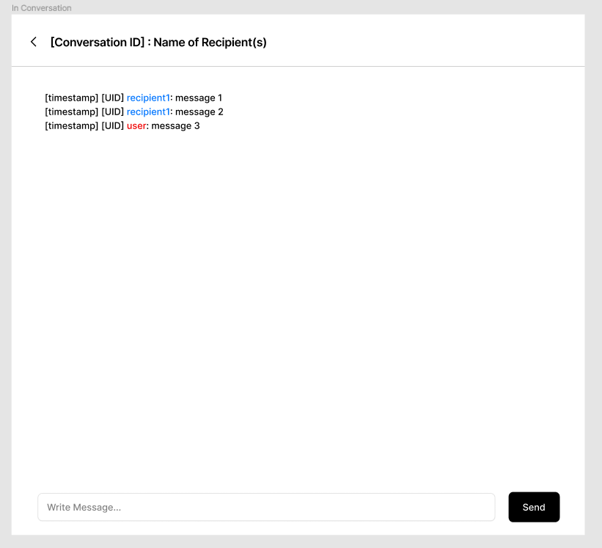
ConversationView
All recipients will be in blue, the user will always be in red.
Every time the send button is hit, the string in the message field is send to the server for processing. The msgField will be cleared.
When a message is received, the message will be added to the ListModel, which will trigger the conversation view to refresh
Segmented into three parts:
titleBar
Conversation ID: Int
Recipient Name(s) : String
backBtn : JButton
messages
ListModel <Messages> : JList
messageBar
sendBtn : JButton
msgField : JTextField
Notes:
Francis

Slide 11
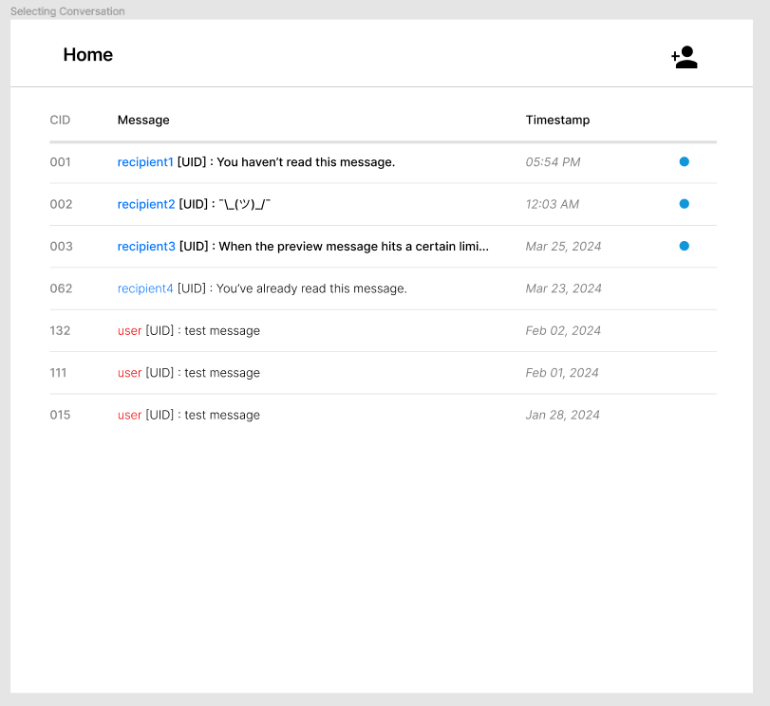
HomeView
All recipients will be in blue, the user will always be in red.
The more recent messages will be put on top of the list.
If the message is sent within the calendar day, the timestamp will display the time.
If the message is sent outside of the calendar day (2 days have passed, 3 days have passed, etc.), the timestamp will display the MMM/DD/YYYY it was sent.
Segmented into two parts:
titleBar
Home : JLabel
createBtn : JButton
conversations
listModel : ListModel <Conversation>
Notes:
Francis

